Slide 1
Calculation Policy Addition – Years 4-6
Kensington Primary School

Slide 2
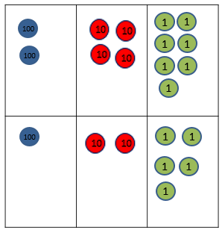
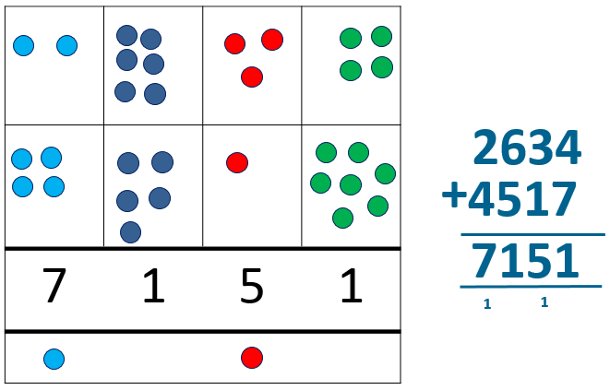
Year 4 | Year 5 | Year 6
Missing number/digit problems: Mental methods should continue to develop, supported by a range of models and images, including the number line. The bar model should continue to be used to help with problem solving. Written methods (progressing to 4-digits) Expanded column addition modelled with place value counters, progressing to calculations with 4-digit numbers. Compact written method Extend to numbers with at least four digits. Children should be able to make the choice of reverting to expanded methods if experiencing any difficulty. Extend to up to two places of decimals (same number of decimals places) and adding several numbers (with different numbers of digits). 72.8 + 54.6 127.4 1 1 | Missing number/digit problems: Mental methods should continue to develop, supported by a range of models and images, including the number line. The bar model should continue to be used to help with problem solving. Children should practise with increasingly large numbers to aid fluency e.g. 12462 + 2300 = 14762 Written methods (progressing to more than 4-digits) As year 4, progressing when understanding of the expanded method is secure, children will move on to the formal columnar method for whole numbers and decimal numbers as an efficient written algorithm. 172.83 + 54.68 227.51 1 1 1 Place value counters can be used alongside the columnar method to develop understanding of addition with decimal numbers. | Missing number/digit problems: Mental methods should continue to develop, supported by a range of models and images, including the number line. The bar model should continue to be used to help with problem solving. Written methods As year 5, progressing to larger numbers, aiming for both conceptual understanding and procedural fluency with columnar method to be secured. Continue calculating with decimals, including those with different numbers of decimal places Problem Solving Teachers should ensure that pupils have the opportunity to apply their knowledge in a variety of contexts and problems (exploring cross curricular links) to deepen their understanding. .

