Slide 1

Maths at Kensington Primary School
Miss Heskett and Mr Raza 2017

Slide 2
Aims of the sessions:
Understand how we teach Maths at Kensington.
Know different ways to support your child’s understanding of basic mathematical concepts including teaching numbers and calculation.
Receive tips for helping your child to enjoy and achieve in maths by using concrete materials and a range of resources.
Work together to solve mathematical problems using different strategies.
- Have opportunities to visit classrooms to observe teaching of maths.

Slide 3

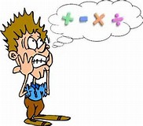
What does the word Maths mean to you?
When do you use Maths?

Slide 4
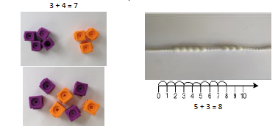
Concrete, pictorial, abstract

Slide 5
Concrete-Pictorial-Abstract approach
It embeds a deep understanding of maths by employing a concrete, pictorial, abstract approach so that pupils understand what they are doing rather than just learning to repeat routines without grasping what is happening.

Slide 6
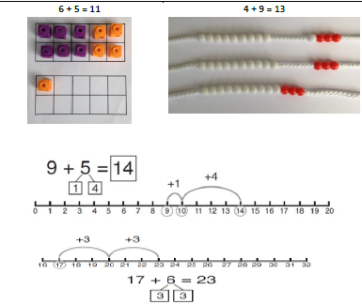
Year 1 addition

Slide 7
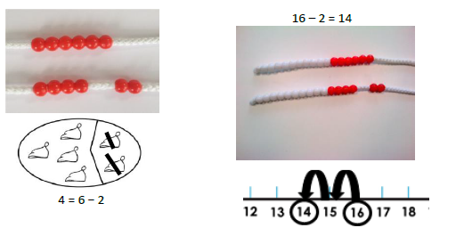
Year 1 Subtraction

Slide 8
Your turn!
Solve the following using the resources on your tables.
15+3=
17+2=
14+3=
7-2=

Slide 9
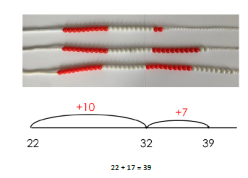
Year 2 addition

Slide 10
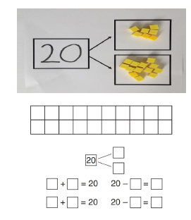
Year 2

Slide 11
Your turn!
Solve the following using the resources on your tables.
25+13=
27+12=
44+13=
27-22=

Slide 12
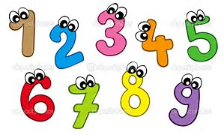
EYFS- Early Learning Goals
Maths: Number, Addition and Subtraction
Count reliably with numbers from one to 20.
Place numbers in order and say which number is one more or one less than a given number.
Using quantities and objects, they add and subtract two single-digit numbers and count on or back to find the answer.
Solve problems, including doubling, halving and sharing.

Slide 13
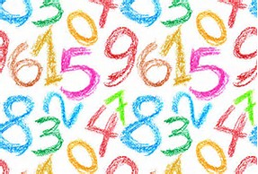
Year 1 Maths Curriculum: Number
- Count reliably to 100. (Forwards and backwards, from any given number).
- Count on and back in 1s, 2s, 5s and 10s from any given number to 100.
- Say the number that is one more and one less than a number to 100.
- Recognise odd and even numbers.
- Write all numbers in words to 20.
- Distinguish between and use: ordinal and cardinal numbers

Slide 14
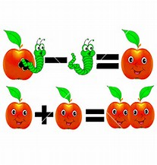
Year 1 Maths Curriculum: Addition and Subtraction
Add and subtract 1-digit and 2-digit numbers to 20, including 0
Add three 1-digit numbers
Recall all pairs of addition and subtraction to 20, including zero.
Solve simple one-step problems that involve addition and subtraction using concrete objects, pictorial representations and missing number problems
Know the signs (+); (-) and (=)
Solve a missing number problem,
such as: 5 = 8 -__

Slide 15
Year 2 Maths Curriculum: Number
Count on in steps of 2, 3, 5 and 10 from any number.
Recognise the place value of each digit in a two-digit number (tens and ones).
Give 10 more or less than any number to 100.
Use ˂ , ˃ and = signs to compare and order numbers to 100.
Read and write numbers to 100 in numerals and words.
Order, read and write numbers in increasing and decreasing value.
Use number facts and place value to solve number facts.
Recognise odd and even numbers.
Distinguish between and use: ordinal and cardinal numbers.

Slide 16
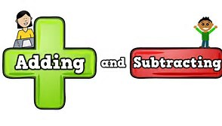
Year 2 Maths Curriculum: Addition and Subtraction
Recall and use addition and subtraction facts to 20 fluently.
Add and subtract mentally up to two-digit numbers using concrete objects and pictorial representations.
Add and subtract up to two-digit numbers using written methods including columnar addition (without carrying or borrowing).
Add and subtract mentally: a two-digit number and ones, a two-digit number and tens, 2 two-digit numbers; and 3 one-digit numbers.
Use subtraction in ‘take away’ and ‘find the difference’ problems.
Recognise that addition can be done in any order but subtraction cannot.
Understand the relation from addition, subtraction, multiplication and division.
Solve addition and subtraction word problems with up to 2-digits.

Slide 17

Thank you for your time.

